Slide 1
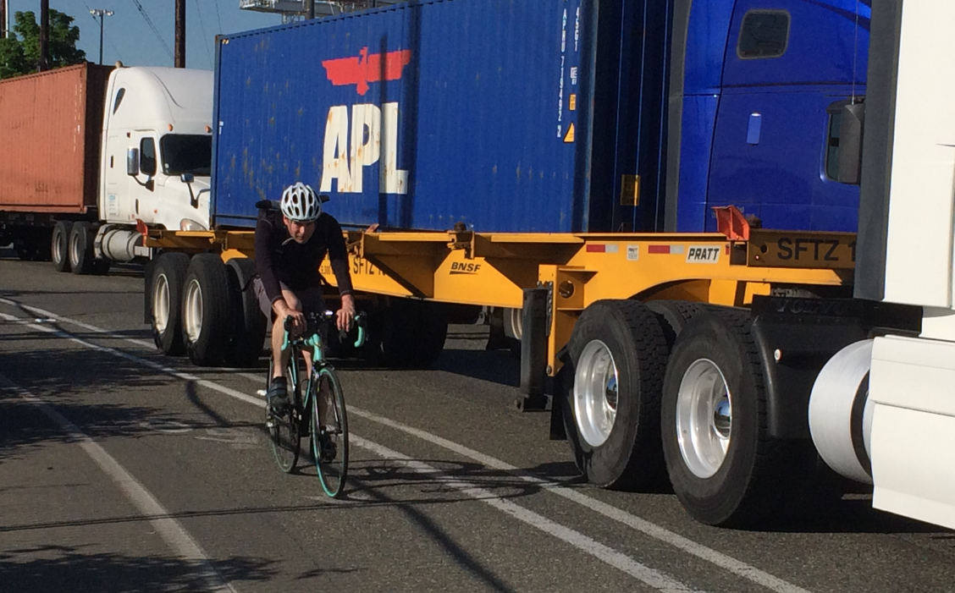
E Marginal Way Project Update
Seattle Bicycle Advisory Board
Megan Hoyt, SDOT

Slide 2
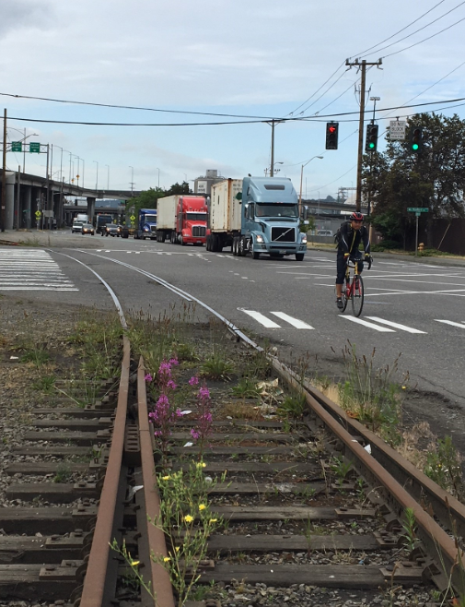
Presentation Overview
Project overview
Progress since July 2018
Phase 1 details
Cost estimate and funding opportunities
Next steps
2

Slide 3
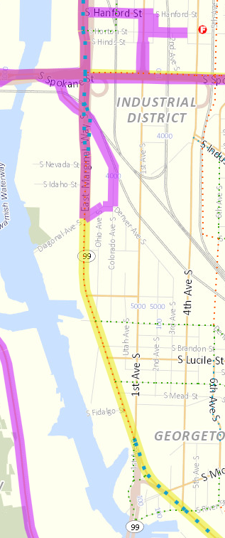


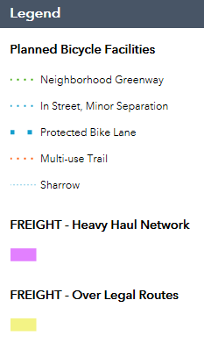

Project goals
Improve freight mobility and access
Promote efficiencies in freight movements
Enhance separation for people walking and biking

Slide 4
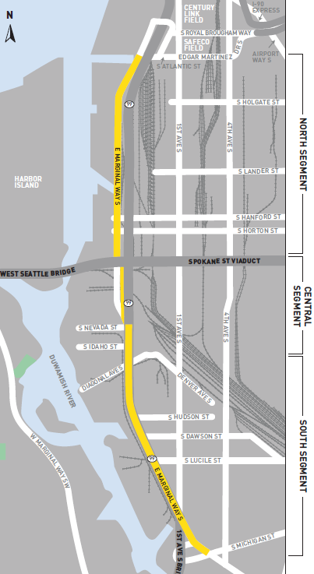
Project limits
North, South and Central Segments
80% of cost is in North segment
Pavement reconstruction
Separated bicycle facility
Sidewalk replacement
Drainage and landscaping
New and rebuilt traffic signals
Signal upgrades
ITS elements
Water main replacement (SPU)
4

Slide 5
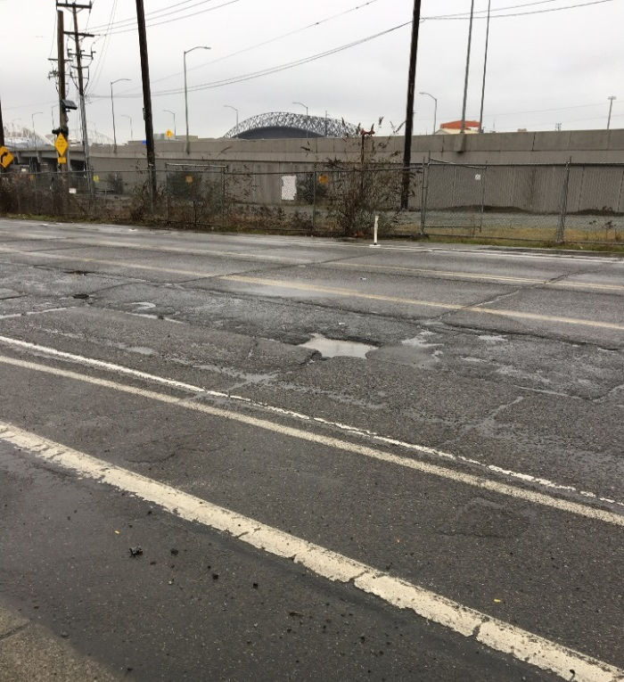
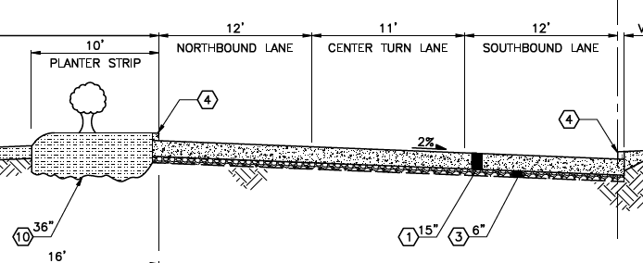
Heavy Haul Pavement Network
Pavement between S Massachusetts St and S Spokane St will be upgraded to Heavy Haul standards
Reconstructs roadway to provide 50-year life
Redesigns intersections and adds adaptive signals to improve traffic flow
Improves freight safety by separating people on bicycles

Slide 6
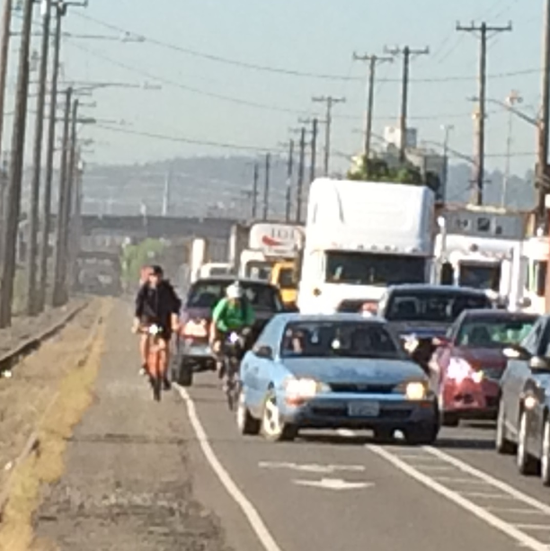
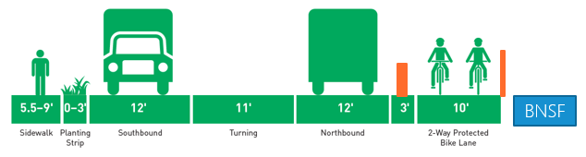
Bicycle Connections
Spokane to Atlantic
1.33 miles of protected bike lane
Physical separation between bicyclists and trucks is a requirement north of Spokane St
Used daily by hundreds of cyclists

Slide 7
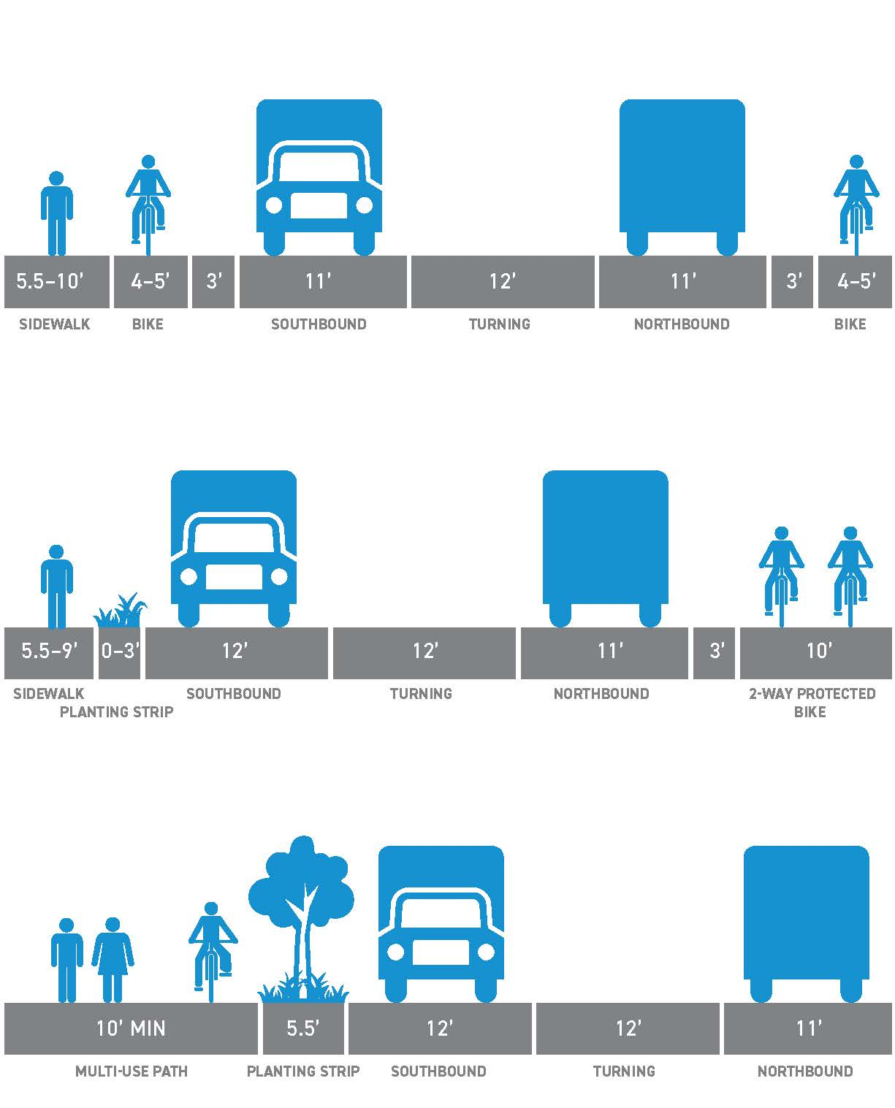
S Atlantic St - S Hanford St Comparison of original options (Spring 2017)
Option 1:
Enhanced existing
Option 2:
2-way PBL east side
Option 3:
Multi-use path west side
7
Facing north

Slide 8
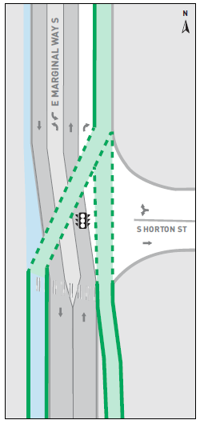
Fully protected bike facility
Continuous concrete barrier between bike lanes and roadway
New signal at S Horton St allows for diagonal movement

Slide 9
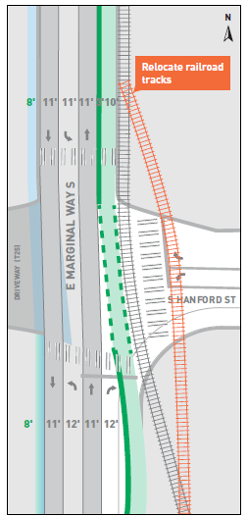
S Hanford St Signal Rebuild
Fully reconstructs traffic signal
Proposes relocating railroad tracks further east and connecting to signal
Fully protected turning movements
Adaptive signal system

Slide 10
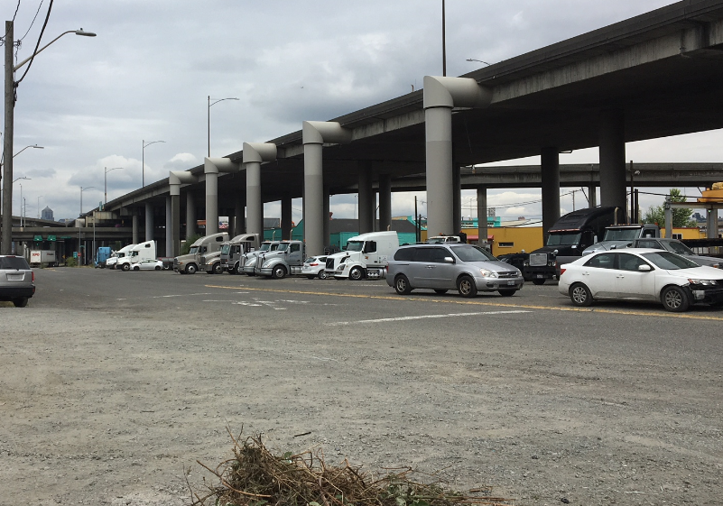
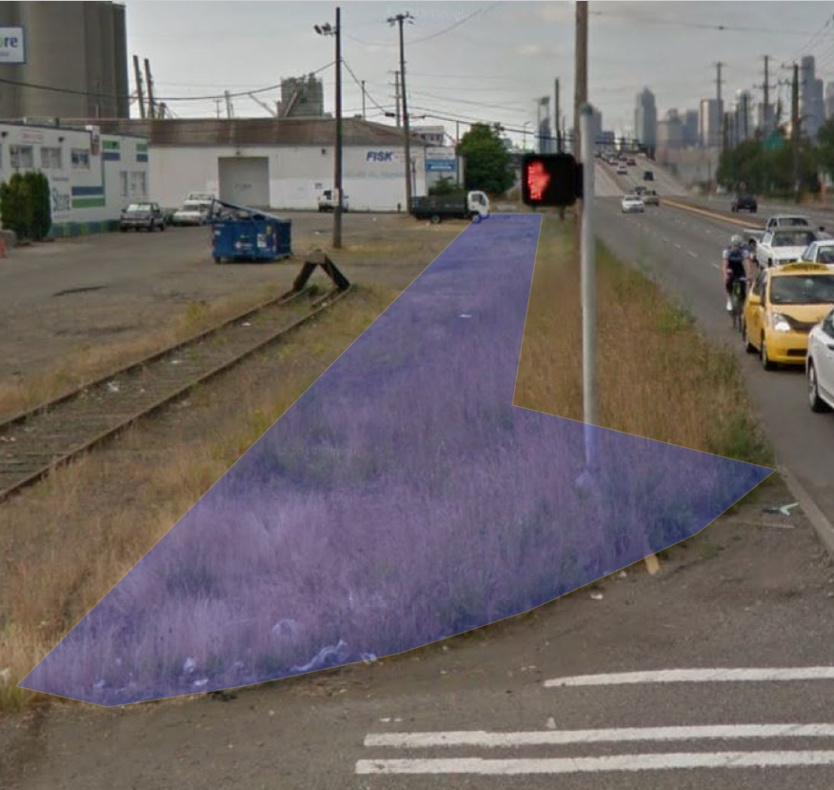
Central segment
Industrial land uses, but key bicycle connection to local businesses
S Spokane St to Duwamish Ave S
Duwamish Ave S to Diagonal Ave S
Construct multi-use trail west of Viaduct
Construct multi-use trail on west side of roadway

Slide 11
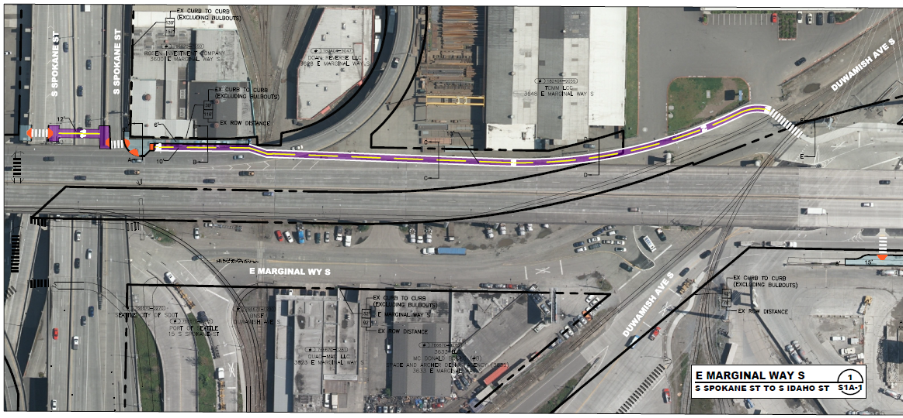
Central segment connections
Insert text
11

Slide 12
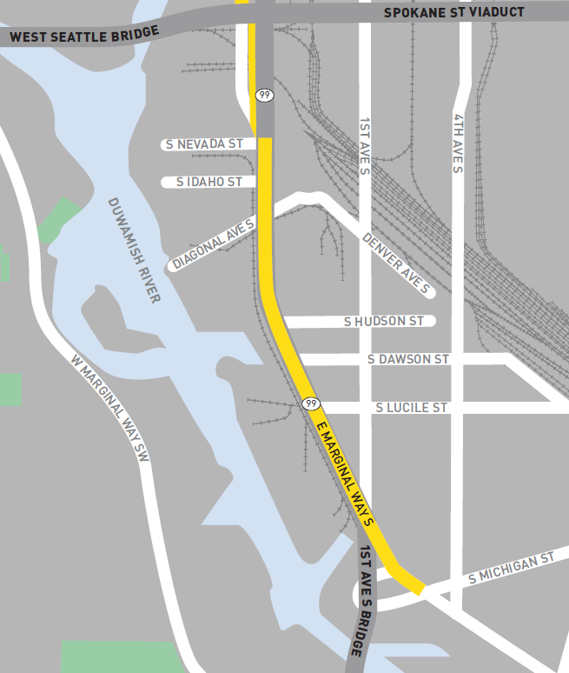
South Segment
Diagonal Ave S to 1 Ave S
Intermittent sidewalk on east side of street
Railroad tracks on west side of street
Little space outside vehicle lanes
WSDOT regulated
12
Notes:
·

Slide 13
Cost estimate
Section | Cost
North: S Atlantic St – S Spokane St | $50 million
Central: S Spokane St – Diagonal Ave S | $7 million
South: Diagonal Ave S – 1 Ave S | $3 million
Total | $60 million
Original expected project cost: $40M - $49M

Slide 14
Funding plan
Current expected project cost: $60M
Source | Amount | Status | Requirements
Levy to Move Seattle | $5 million | Secured
FMSIB | $6 million | Secured | Paving only
FHWA (PSRC) | $2 million | Secured | Bike only; 2021
TIB | $3 million | Secured | Bike only; 2020
 | $16 million | Total Secured
Source | Amount | Status | Requirements
FHWA (PSRC) | $4 million | Pending | Design Only: North and Central Segments
 | $4 million | Total Pending

Slide 15
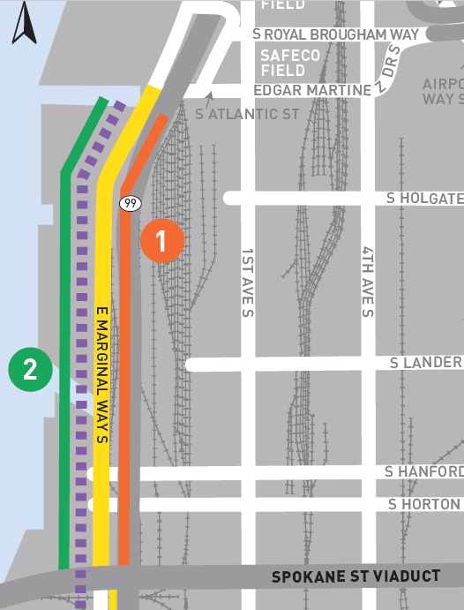
Proposed Phasing
A phased approach utilizes current secured funding
Phase One - $10.5M
Bicycle facility between S Atlantic St and S Spokane St
Rebuild signal and relocate railroad track at S Hanford St
New signal at S Horton St
Phase Two
Roadway reconstruction to Heavy Haul standards
Replace west sidewalk
Water main replacement (SPU)

Slide 16
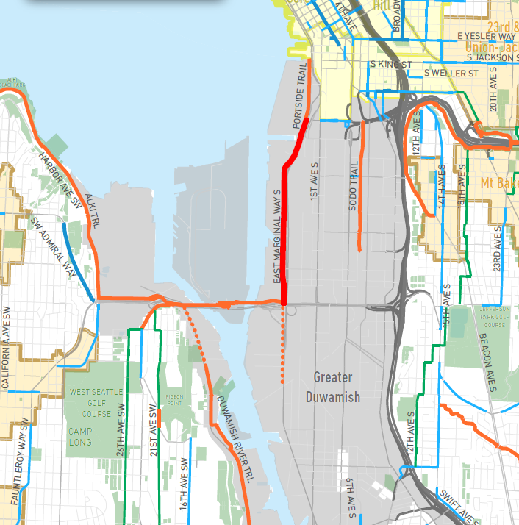
Phase 1 Value
Constructs safety improvements
Connects downtown Seattle to regional bike network
Rebuilds busiest freight intersection and upgrades signals/detection
Early implementation of full project

Slide 17
Phase 1 Funding
Utilizes all remaining Levy funds
Includes partnership with other Levy Programs:
$150K from Freight Spot Improvements (design)
$150K from Freight Spot Improvements (construction)
$300K combined from New Signals, Signal Major Maintenance and Signal Spot Maintenance
Potential to include design funds from Bicycle Master Plan implementation
Allows SDOT to meet grant requirements
Future Funding
Will require regional support from State representatives, WSDOT, and Port of Seattle
Funding Plan and regional support is not confirmed; SDOT does not plan to apply for federal funds in 2019

Slide 18
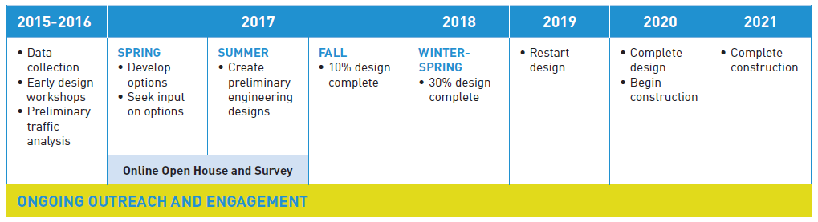
Schedule

Slide 19
Next Steps
Design and Construct Phase 1
Design Phase 2 (if pending FHWA design funds received)
Apply for federal INFRA/BUILD funds once funding plan and regional support are secured
When do you want future updates?
Specific design milestones?
Funding updates?
Design questions?

Slide 20
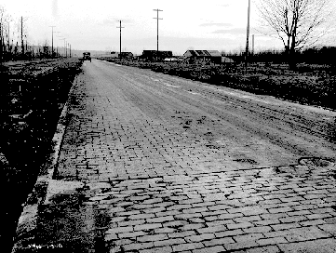
Questions?
Seattle Department of Transportation
Megan Hoyt, E Marginal Way Project Manager

